Slide 1


SAP UI5 & FIORI with OData TRAINING
Anubhav Oberoy & Shekhar Vedi
Day – 6

Slide 2

Agenda – Day 6
Concept of Model in UI5
Understanding Important point related to models
Steps to create model
Addressing model in views
Concept of Base Controller in UI5
Concept of binding in UI5
Expression Binding
Binding Modes
Aggregation Binding
Element Binding

Slide 3
Models in SAP UI5
The various model types supported by SAPUI5 are:
OData model
JSON model
XML model
Resource model
Each model in SAPUI5 is mainly used to bind controls to the data brought in. The JSON model is a client-side model which is recommended for datasets with small amounts of data.
Usage of Models:
%
100
100
100
95
80
Usage in Percentage
60
40
40
20
Models
OData
JSON
XML
Resource

Slide 4
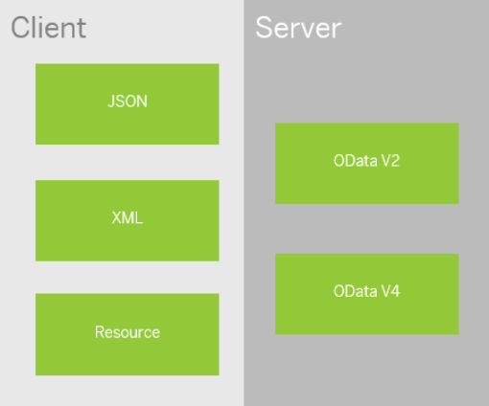
Model Basics
All the models in SAP UI5 are characterized in two different parts:
Client-Side Model: -
A model which keeps all the data in the browser. We use client-side model for manipulating data (like internal table).
Server-Side Model: -
Keeps data on server side, and ON-demand, it is loaded by client using the server-side model.
We can use the APIs (Methods) provided by SAP to access data from model
We need to get model object using methods
getModel(modelName)
setModel(modelName)
From model object we get access to the data using methods
setProperty(sPath, sValue)
getProperty(sPath)

Slide 5
Steps to Create a Model
3 Easy Steps to Create a Model
Step 1: Create a brand-new object of the Model
To Create JSON Model - var oModel = sap.ui.model.json.JOSNModel()
To create XML model – var oModel = sap.ui.model.xml.XMLModel()
To create Resource model – var oModel = sap.ui.model.resource.ResourceModel()
To create OData Model – var oModel = sap.ui.model.odata.v2.ODataModel()
Step 2: Set or Load the data in the Model
oModel.setData({});
oModel.loadData(filePath);
Step 3: Make the model aware to the application/view
sap.ui.getCore().setModel(oModel);
this.getView().setModel(oModel);
Create object of the Model
Set/Load Data in Model
Set Model at View Level

Slide 6
How to Address Model Properties?
In the json data we can make address as “Every curly braces is converted to / and every array item is converted to /index”.
{
"empStr": {
"empId": 0001,
"empName": "Anubhav",
"salary": 8000,
"currency": "USD"
},
"empTab": [{
"empId": 0009,
"empName": “Ananya",
"salary": 9500,
"currency": "USD“
}, {
"empId": 0010,
"empName": “Shwetha",
"salary": 10000,
"currency": “EUR"
}]
}
Q: what is the salary of Anubhav
-
Q. What is the emp name of emp 0001
-
Q. What is the salary of Shwetha
-
Q. What is the empId of Ananya
-

Slide 7

Exercise
Model Exercise 1
In this exercise we will create a JSON model using a JavaScript Object.
After Creating the model, we will bind the model to the XML view in a Simple Form
Exercise code/resource:
MyView.controller.js
MyView.view.xml
Model Exercise 2
In this exercise we will create a model.js file, In that file we will write code to create the model dynamically.
After that we will create two model and bind them with the form and on click of a button the model will be flipped.
Exercise code/resource:
MyView.controller.js
MyView.view.xml
models.js
mydata.json
mydata2.json

Slide 8
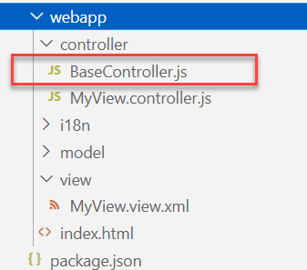
Concept of Base Controller in UI5
Base Controller:- A base controller is a controller with basic functionalities from which the other controllers in your SAPUI5 application inherit.
The base controller holds basic functionalities that are used across multiple controllers.
The base controller itself is just another JavaScript file and it does not have the .controller prefix. Just BaseController.js and not BaseController.controller.js.
The base controller goes in the controller folder in your SAPUI5 application folder structure:
sap/ui/core/mvc/Controller
x
BaseController
Template
x
Controller 1
x
Controller 2
x
Controller 3
x
Controller 4
View 1
View 2
View 3
View 4

Slide 9

Exercise
In this exercise we will create a new BaseController.
Along with that we will see how to load data to a model from a file.
Exercise code/resources: -
MyView.view.xml
MyView.controller.js
BaseController.js
mydata.json
mydata2.json
mydata.xml
model.js

Slide 10

Concept of Binding in SAP UI5
Data binding is the process that establishes a connection between the application UI and business logic.
It is a bridge between a binding target and a binding source.
Sap ui5 provides three binding options
Property Binding
Expression Binding
Aggregation Binding
Element Binding
Property Binding:- When we bind property of a UI control, to the address of the model, this is called property binding. E.g., value property of Input control was connected to /emp/empId
Ex:-
In XML view:- <Text text=“{/emp/empId}” ></Text>
In controller: - this.getView().byId(“controlId”).bindProperty(“text”, ‘/emp/empId’);

Slide 11
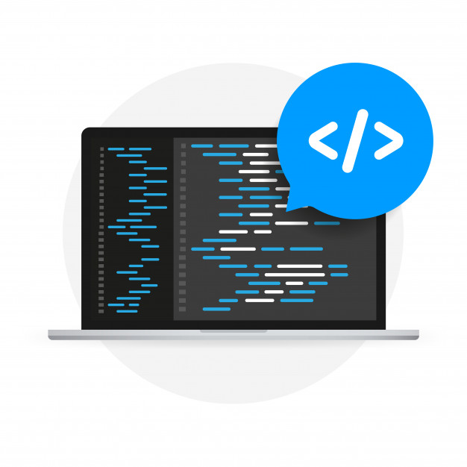
Expression Binding
Expression binding : - When we bind an Expression ({= condition ? true : false}) with the property of a control rather binding value to a property, this is called expression binding.
If we need some calculation on model data or some sort of comparison, then expression binding is useful.
Syntax:
numberState = “{= ${path} > value ? ‘conditionForTrue’ : ‘ConditionForFalse’ }”
Use Case of Expression Binding
My Manager want to add a button and when we click on that button, all the fields should gray out.
If The Employee Name is Anubhav, Gray out Salary field.
Condition – if employee name = Anubhav
Outcome – make field gray out
Target – Salary field

Slide 12

Exercise
In this exercise we will see the example of both property binding and expression binding.
In this file we also see that how to get data form the file in the model.
Exercise code:-
MyXML.controller.js
MyXML.view.xml
index.html

Slide 13
Binding Modes
There are basically three modes of binding data in SAPUI5.
One-way binding – Here, the data is transported in one direction only, i.e., from the model, through the binding instance to the consumer (usually the property of a control), but never in the other direction. Any change done on the model data from the front end is not affected to the model. All the data changes are reflected only on the controls.
Two-way binding – Here all input changes done from front end controls are reflected on the model and the backend database. SAPUI5 automatically handles the transport of data both from the model to the controls and back from the controls to the model.
One-time binding – Here all data will be bound from model to view just once. After that, the connection is no more set.
Data
Data
Model
View
Model
View
Data
One-way binding
Two-way binding
Data
Data
Data
Model
View
Model
View
One-Time binding

Slide 14
Aggregation Binding
When we bind the aggregation of a control with the entityset of data model, it is called aggregation Binding.
The parent control (e.g. Table) is bound to the EntitySet path which is called absolute path and the child of the parent Control (e.g. Columns) are connected to the child properties of the EntitySet is called relative path.
In aggregation binding, based on your model data, as many child controls will be created automatically.
Every Event of UI5 will trigger the eventHandler and we will get the Event Object as part of the event Handler. Depending on the event, the event handler object will have different parameters.
Use Case of Aggregation Binding
If we want to show a list or some data in tabular format, we need to bind a group of data. In such a case we will use aggregation binding.
Absolute path
{
“empTab”: [
{
“empId”: 50,
“empName”: “Jay”,
“salary”: 9500
}
]
}
Table = {/empTab}
Emp Id | Emp Name | Salary
{empId} | {empName} | {salary}
Relative Paths

Slide 15

Exercise
In this exercise we will create a table and load the data of some employees in it.
We will see how to use different controls in a table to represent data.
Exercise code/resource:-
MyView.view.xml
MyView.controller.js
mydata.json

Slide 16

End of Day 6

Slide 17

Questions

Slide 18

Anubhav Oberoy

Slide 19


We’re committed to empower you to be
Most Desirable Resource
through powerful training solutions.
We build the workforce of the future.
250+
Corporate Clients
30,000+
Learners Trained
25000+
Learners Placed
FREE WEBINARS
Sign up for free webinars with industry experts every fortnight!
Enroll Now!
Contact us today!
https://anubhavtrainings.com/

Slide 20




More from AnubhavTrainings.com

Slide 21
Title
Content

